Slide 1
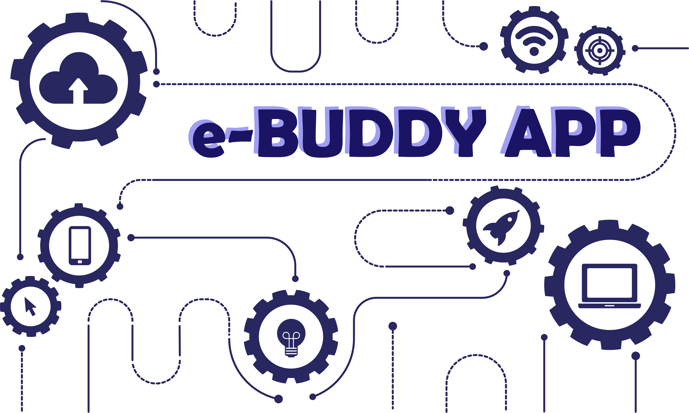

Slide 2

e - BUDDY APP
where Buyers meet Sellers
SUBMITTED BY :-
(DELL_DWELLERS)
AUNKITA MANDAL(1705687)
RUPSA BANERJEE(1705728)
SHUCHISMITA MITRA(1705741)
TANYA BHATIA(1705753)
KALINGA INSTITUTE OF INDUSTRIAL TECHNOLOGY,
DEEMED TO BE UNIVERSITY
BHUBANESWAR, ODISHA

Slide 3
Problem Statement & Benefits
Problem Statement :
Biz Users spends lot of time in explaining any new functionality to new team members/development teams/stakeholders/support team members
Deficit of Domain knowledge across the teams
Recorded Video’s/Documentation becomes obsolete and not interesting
New product launch/configuration is very time consuming
Development teams spends unproductive hours to explain supporting team members
Each functional groups implements their own solutions and there is inconsistency across supply chain Org
Benefits :
New features onboarding can be quick/nimble
Consistency across teams in leveraging standards
Able to constantly update the changes
Improved Team member experience
Reduce time spent

Slide 4
Expected Outcome
Supply Chain Buddy App:
Would like to have plugin play solutions for any team who likes to
onboard similar solutions by leveraging latest technology like
mixed reality/AI and enhance Supplychain and team member
experience
– Elaborate functional flow in creative way
– Developer Playbook to emphasize coding standards
– Help to onboard business scenarios
– User Education
– Clarify functional queries
– Provide recommended technical solutions

Slide 5
Our Approach...
A very basic implementation of a user friendly website which is designed using Angular 8. The front page of the website offers you to log in or sign up as a new user. When you create a new account, you can sign up as an admin, supplier or a customer. All the recent purchases and sales of the supplier or customer is maintained at the back-end which is updated in a database which has been created by using MySQL through Xampp 7.2.20. The website can perform all the CRUD operations using the PHP files which are maintained at the back end. There are proper demonstrations for a first time user as to how to access the application and make use of its various functionalities.

Slide 6
Discussions
The major content of this architecture are following:
•User Interface (WEBSITE Application)
•Admin XAMPP
Firstly, we need the quantity information of certain products and the information of producer producing variety of products.
Secondly, an account for each user is created and all the information is stored in the database as to who bought, where was it produced and by whom and how much was sold at what price.
Finally, we store the information of the each of the above stated facts in our database. For this purpose, we use xampp V3.2.4. The GUI (frontend) of the buddy app is designed using Angular V8,and the linking of the website to the database is done by using php files.

Slide 7
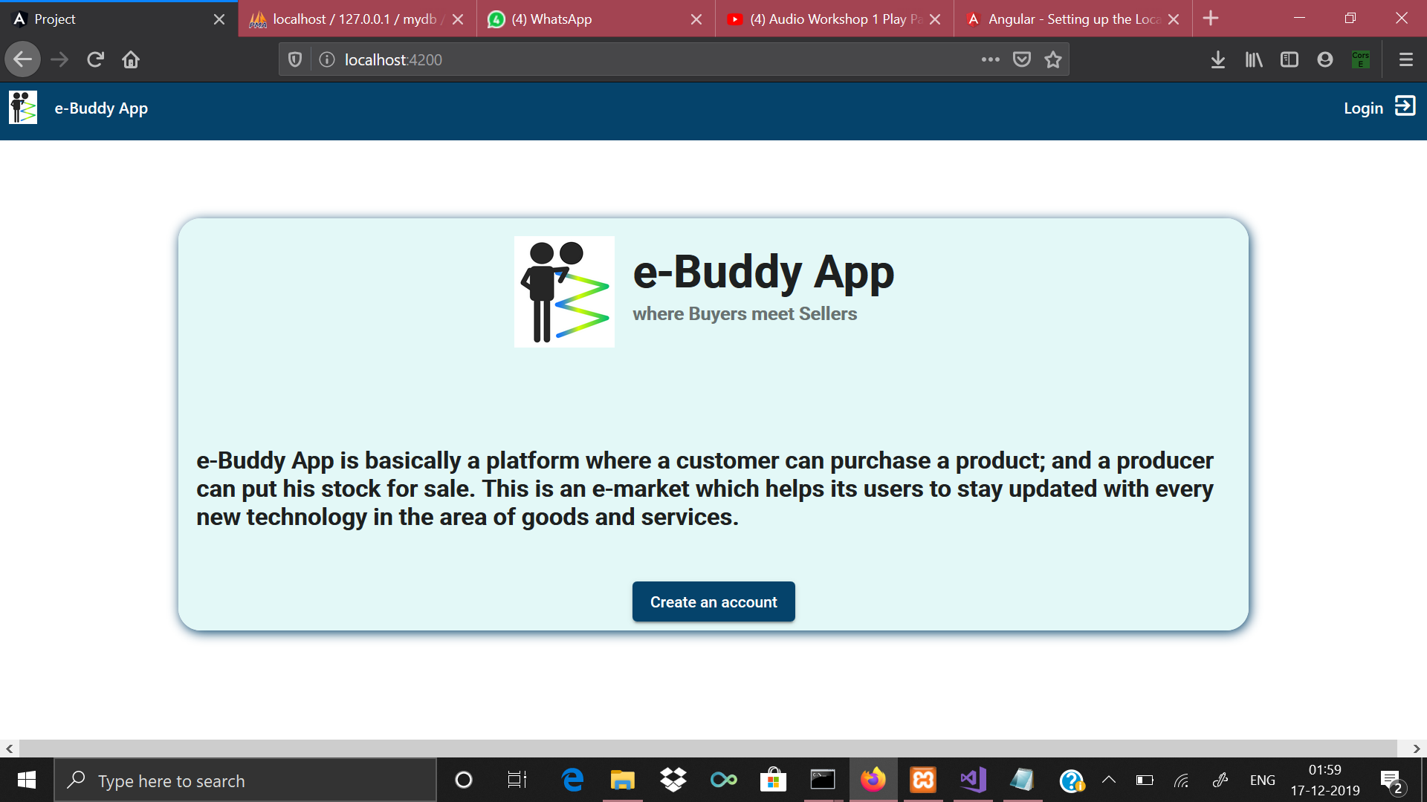
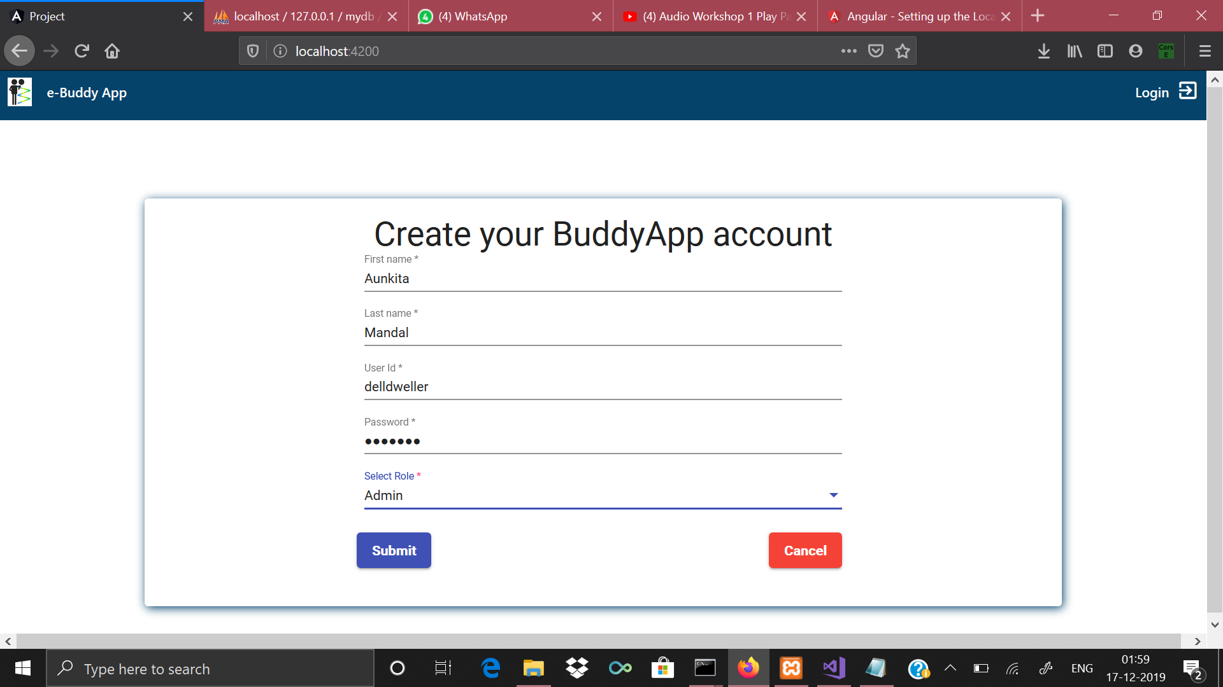
Some glimpses of our work...

Slide 8
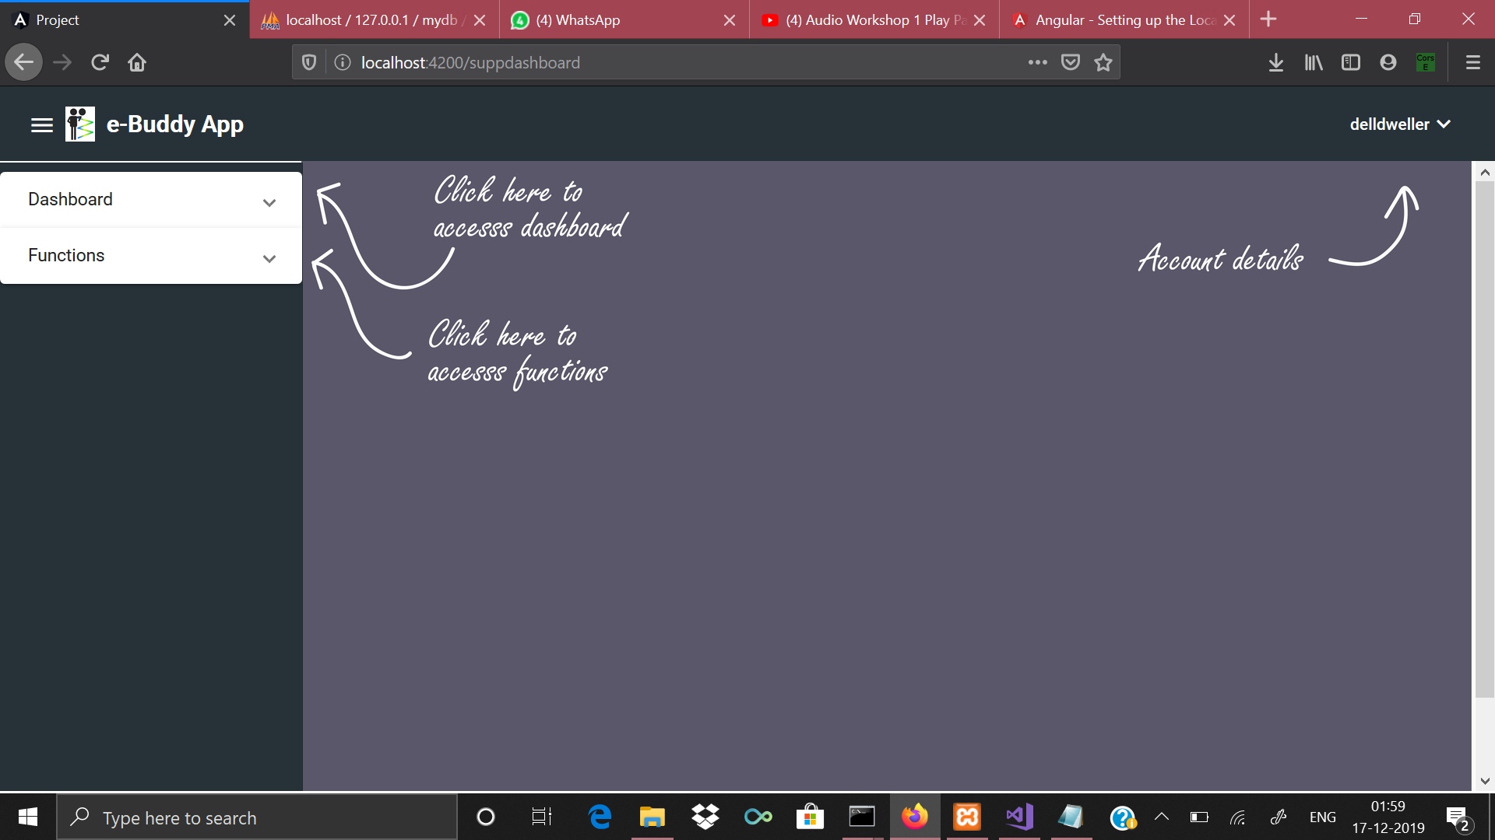
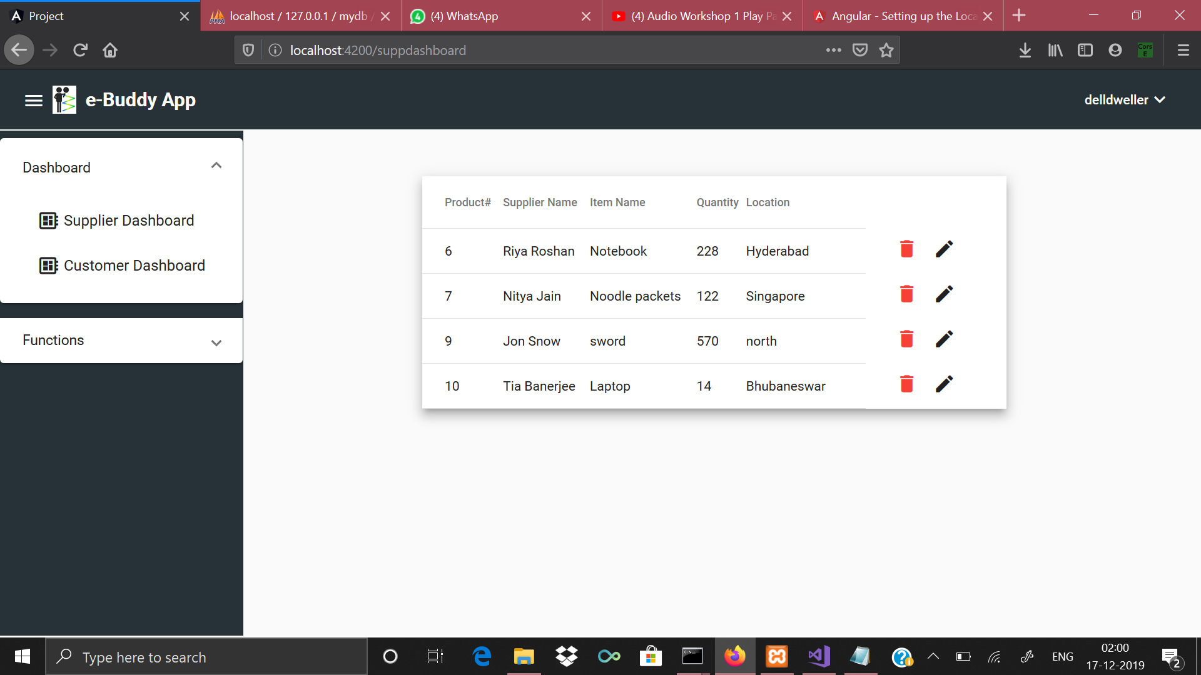
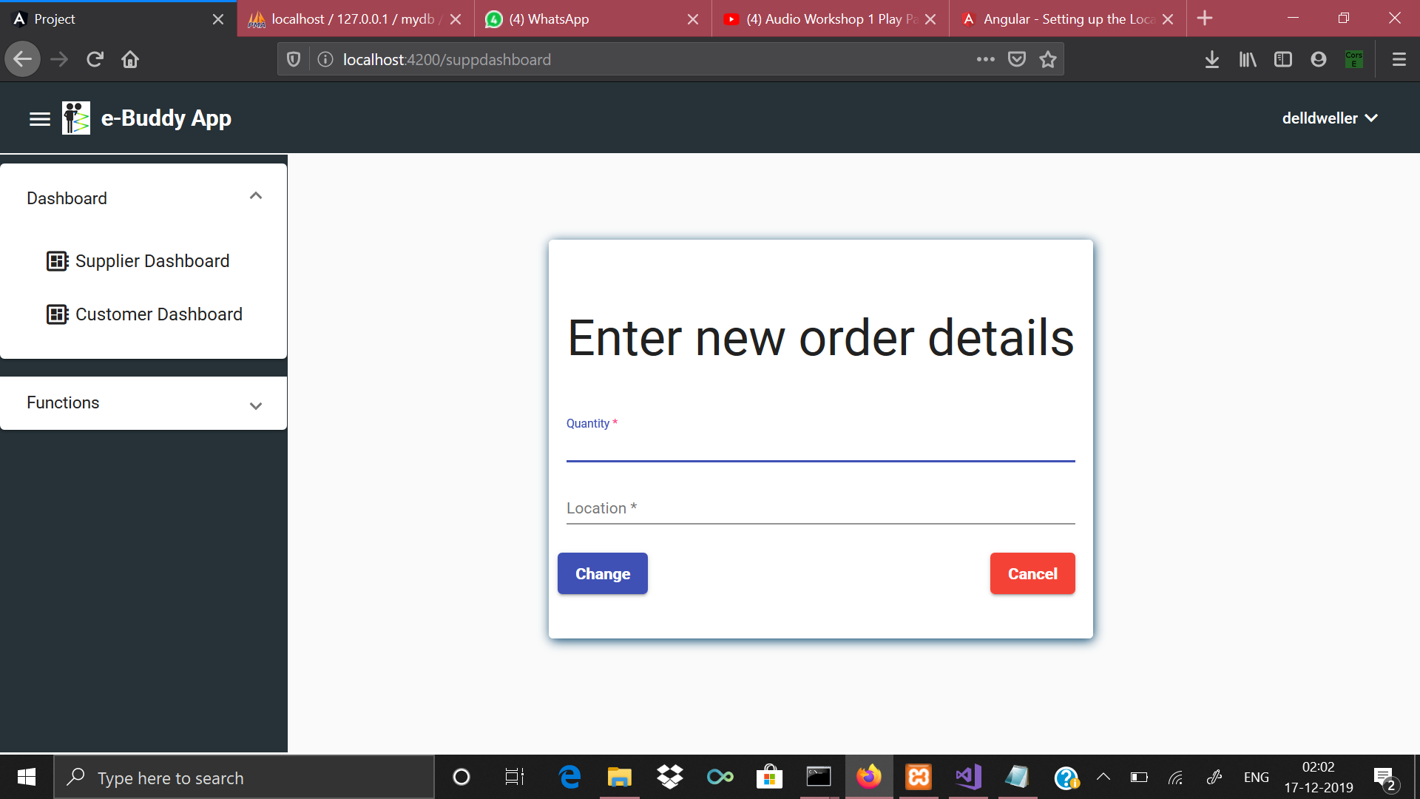

Slide 9
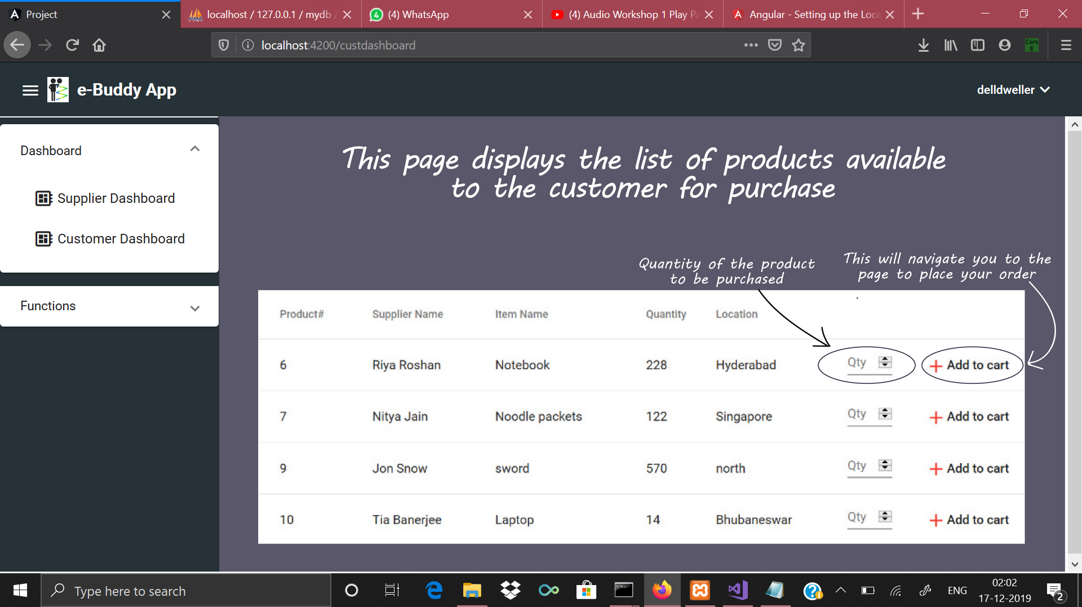
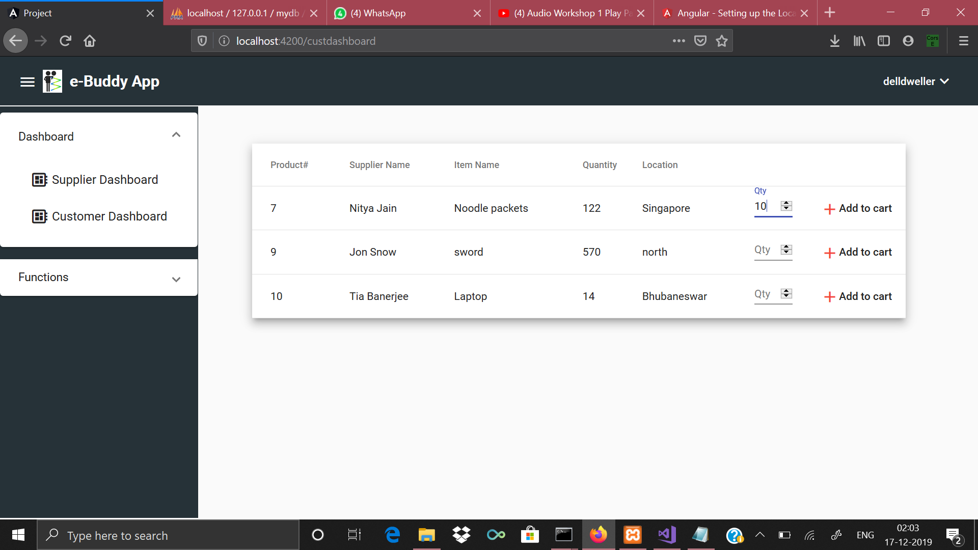
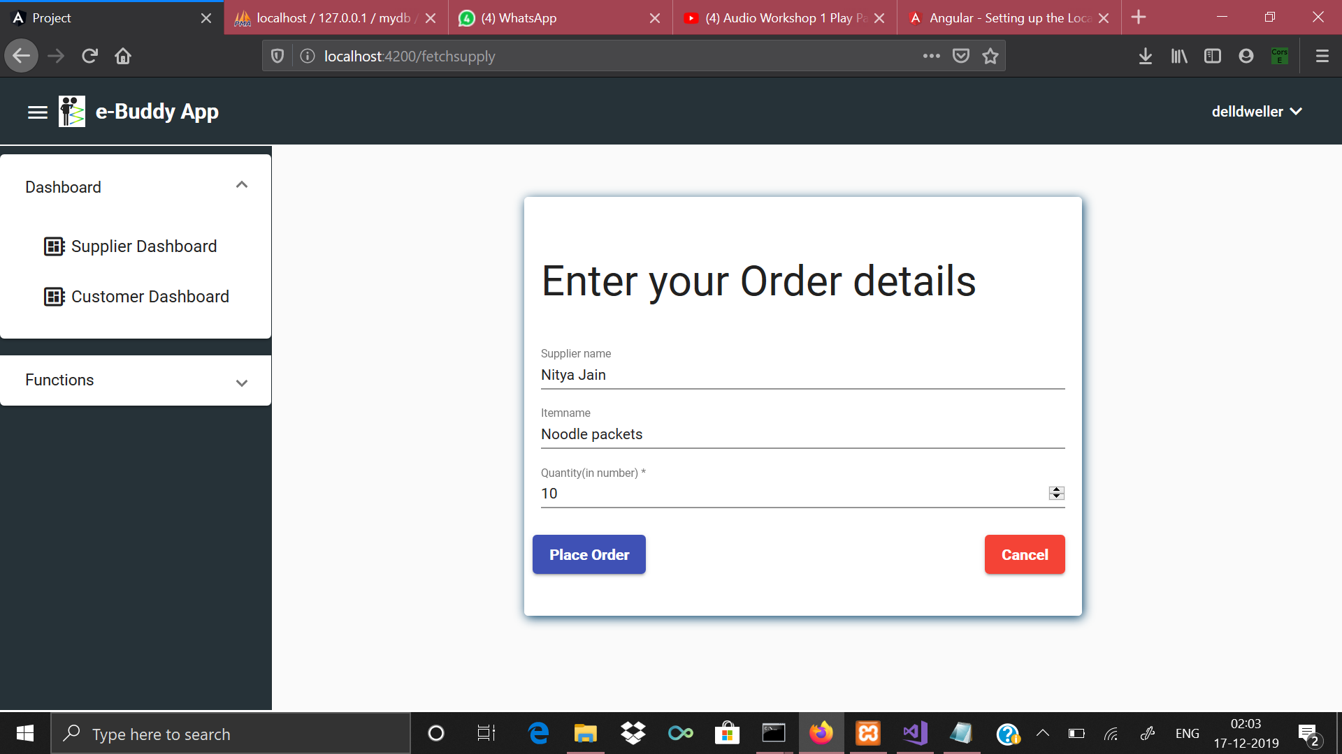

Slide 10
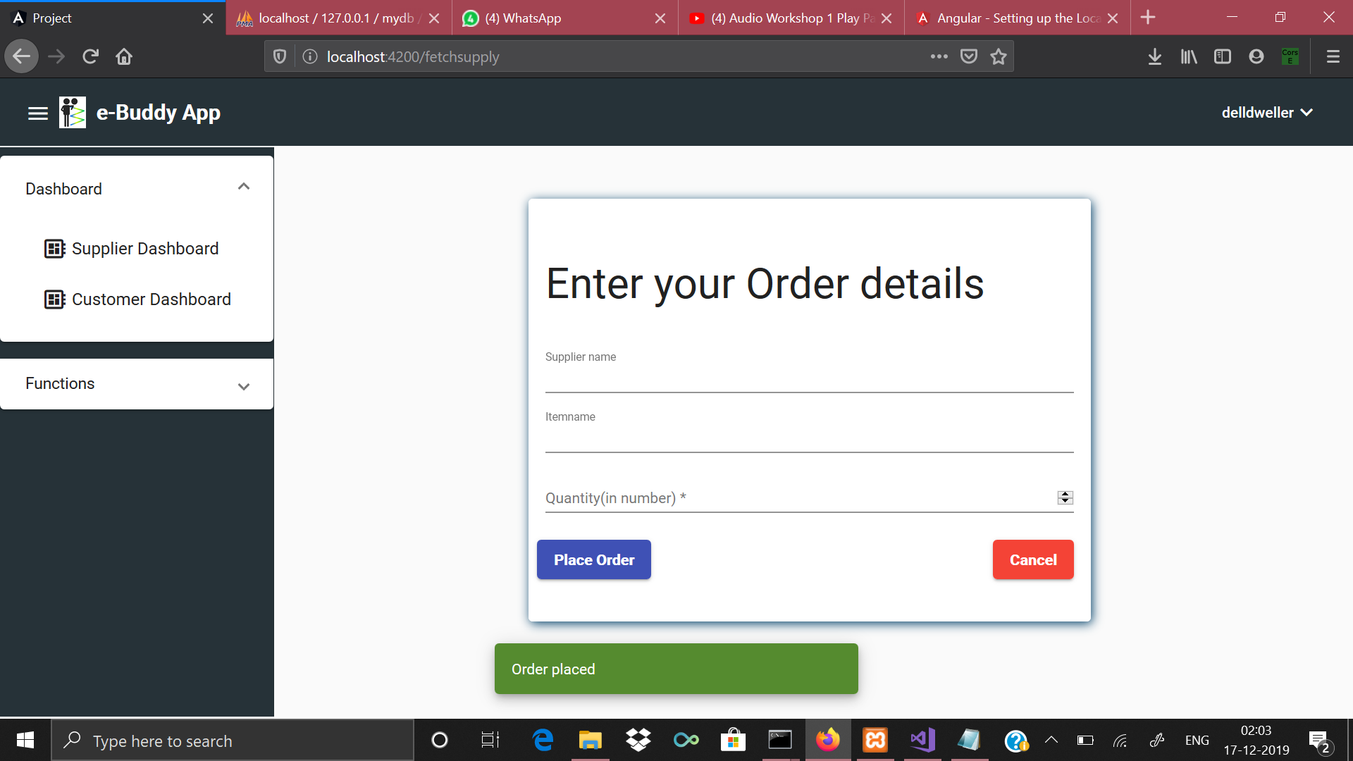


Slide 11
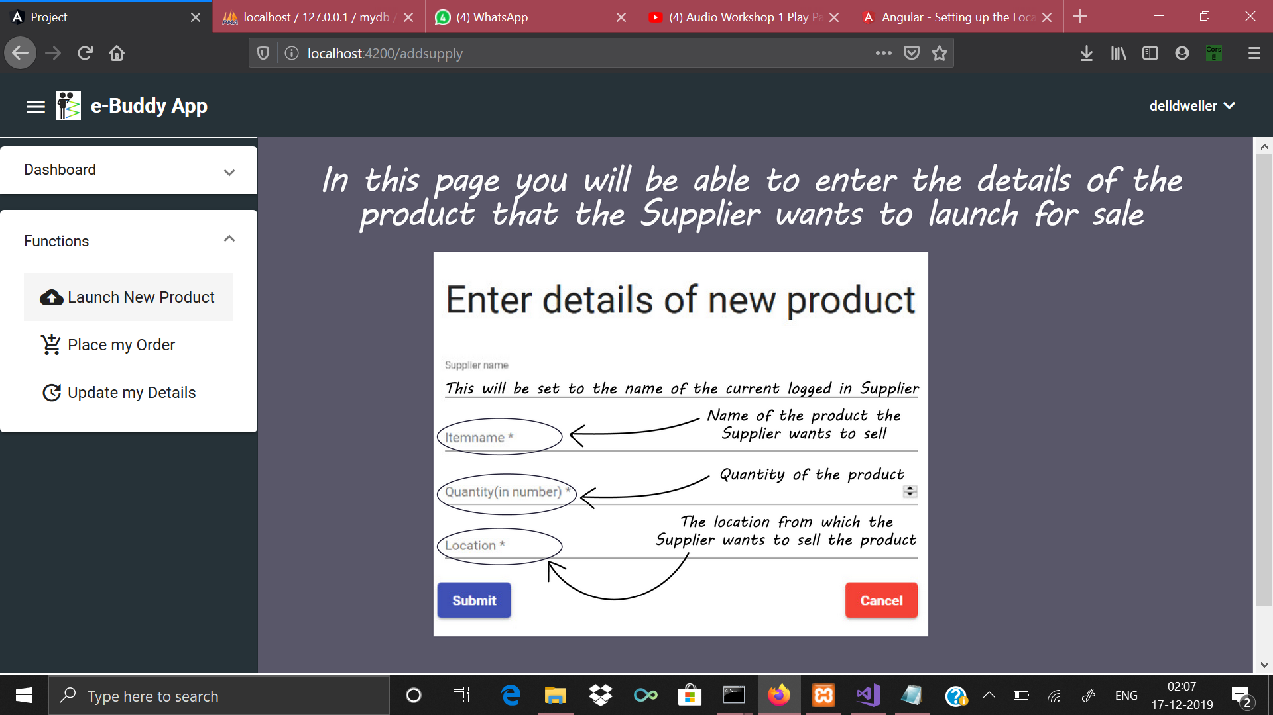
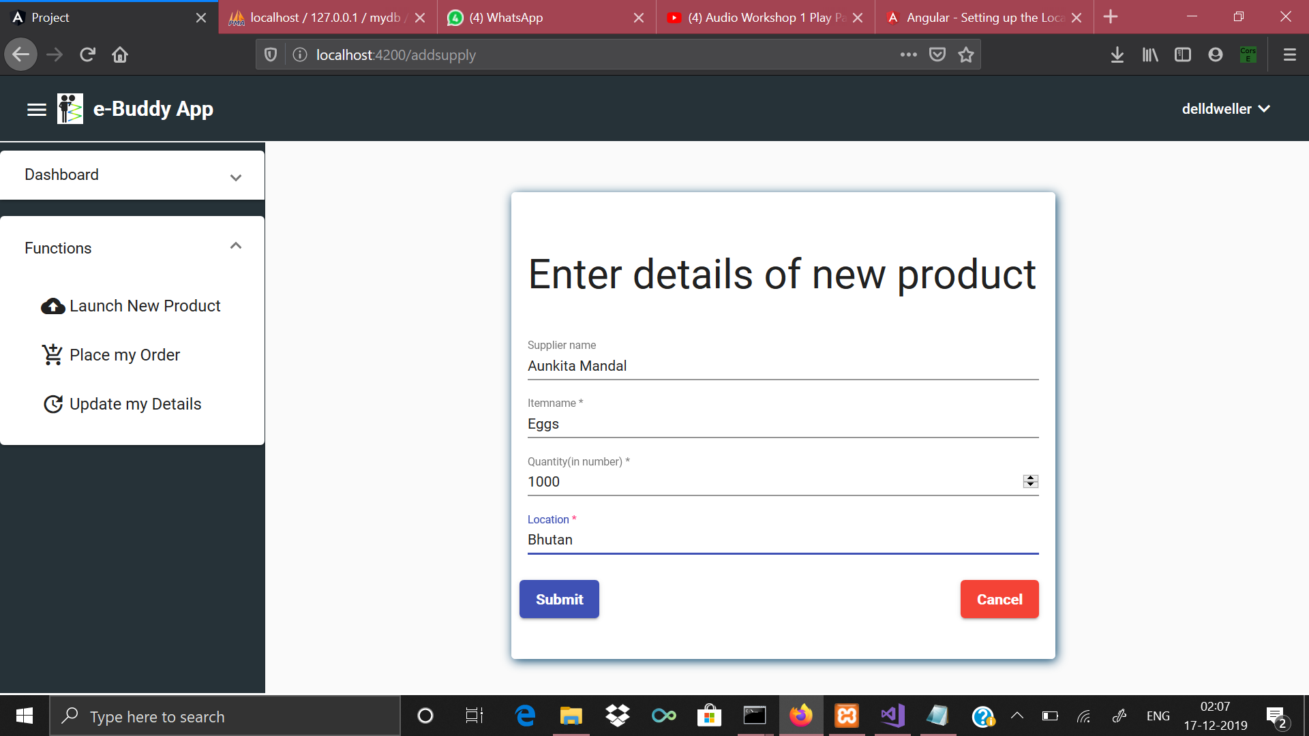

Slide 12
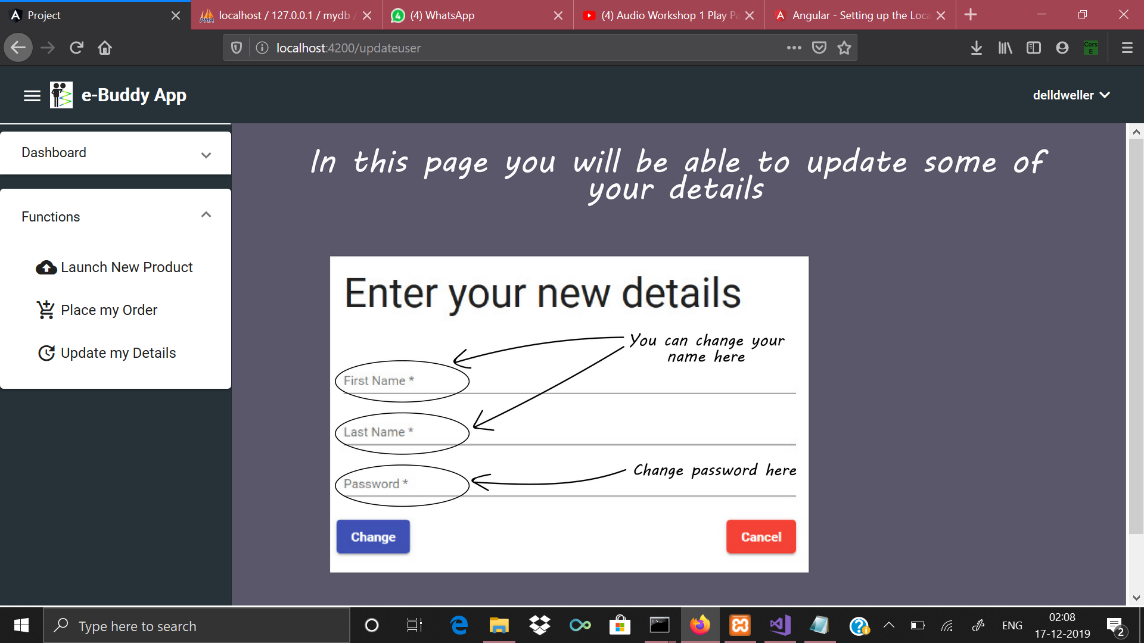
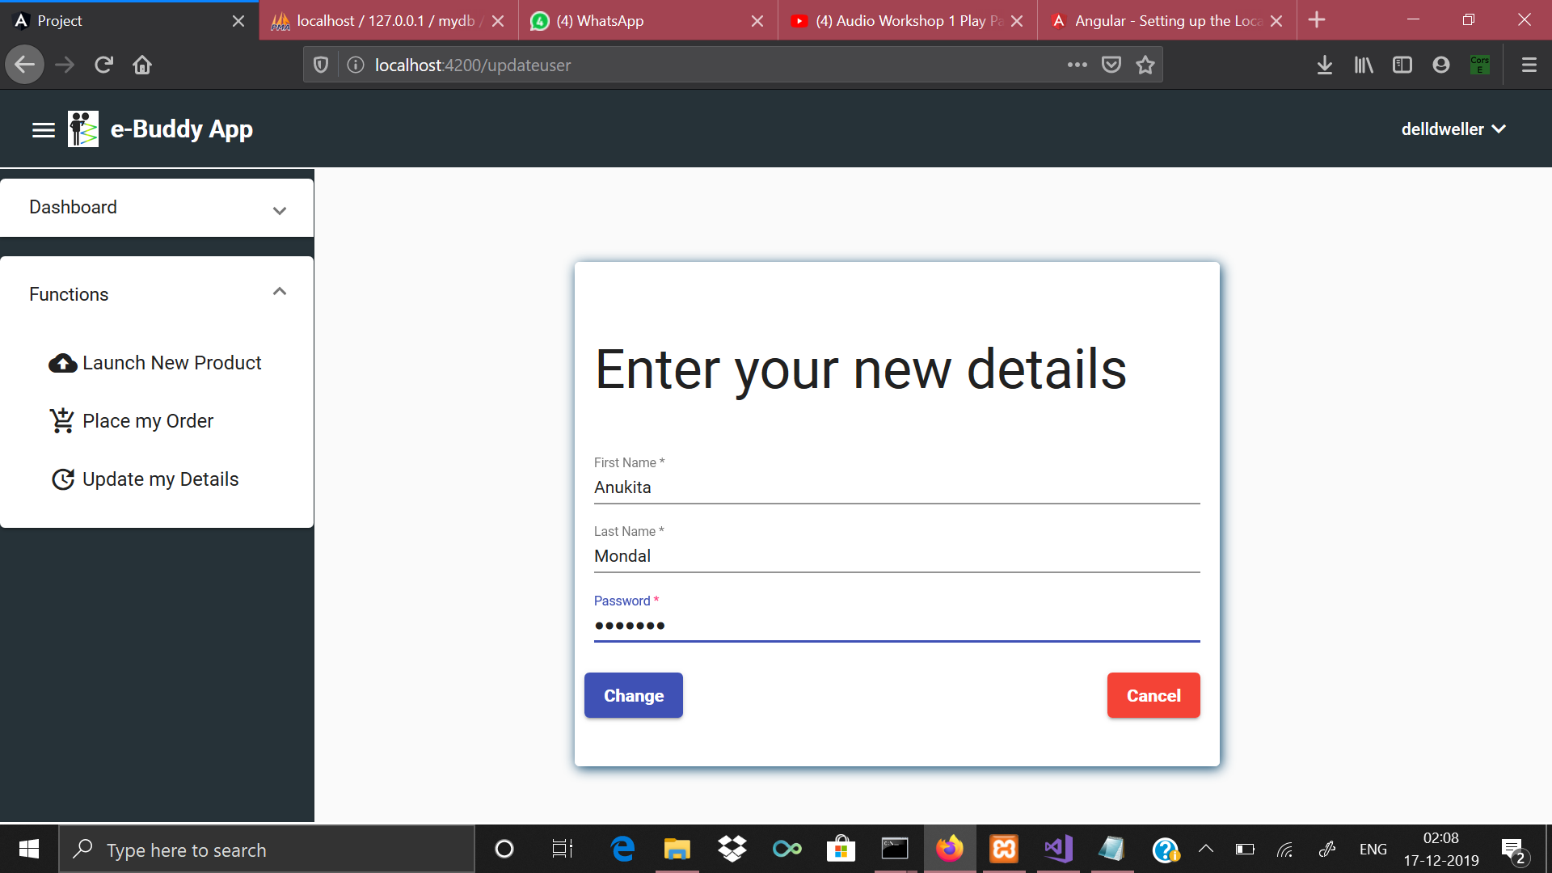

Slide 13
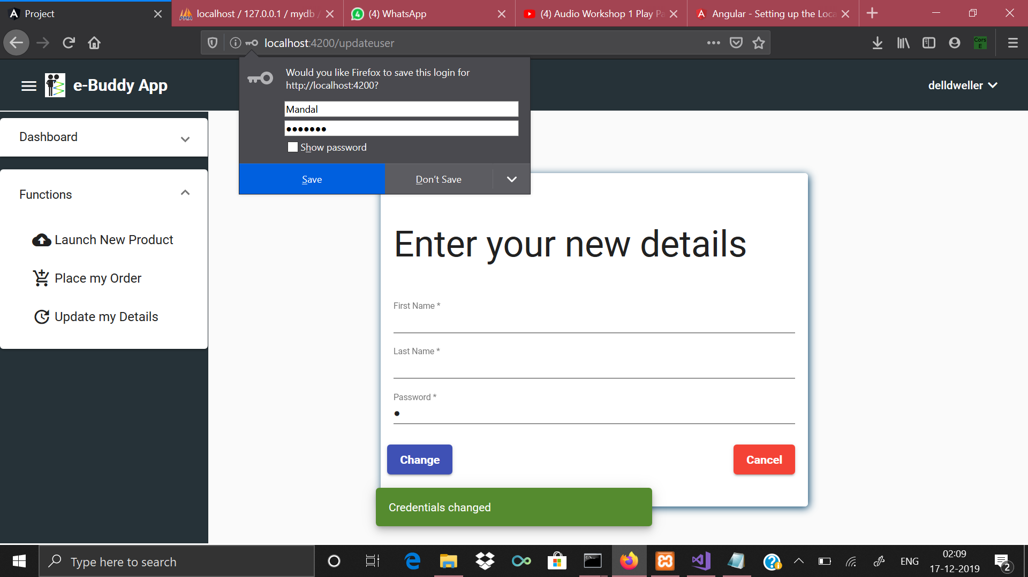
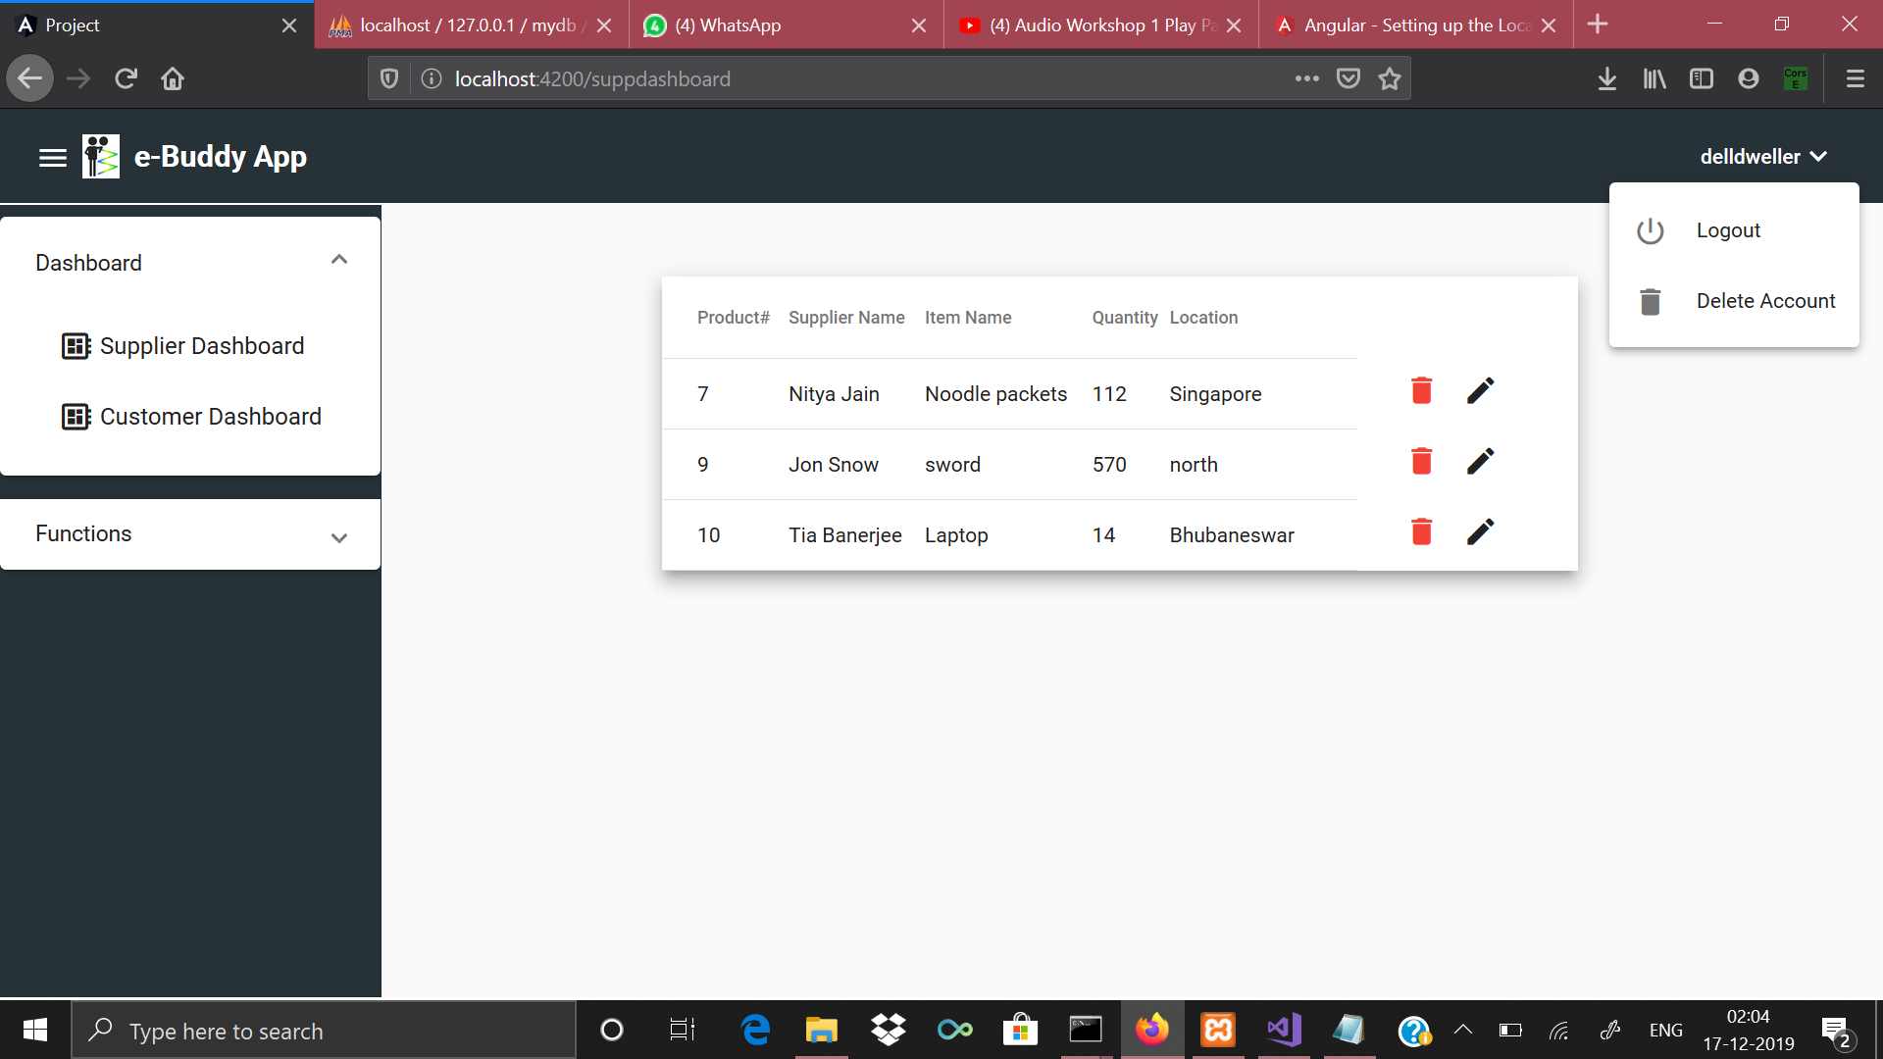

Slide 14
Future Goals...
1)Implementing a ChatBox: The user can ask his query in the chatbox where he’ll receive automated replies from the bot. The details of the newly added functionalities could be transported in the supply chain of business organisations with a lot of ease when a user could get all the queries answered through a chatbox. There are numerous companies who have already implemented such features but our approach was mainly hitting on the keywords and generating multiple answers for the same in a recommended fashion.
2)Demonstration by an audio: Whenever a user is redirected from one page to another in a website, he does not have much idea as to how to go on with the app. Our approach to this problem is that whenever a user clicks on a button and is redirected to a different location for the first time, he shall hear an audio playing in the background explaining the functionalities in detail.

Slide 15
Contd...
3)Demonstration by a video: generally, video lectures for everything is present in you-tube but these are time consuming, boring and obsolete ways of communicating information. We have come up with an innovative idea where we could involve the user in the video itself and he could just click on the tabs and icons and learn the working of an entire app like a game.

Slide 16
Bibliography
https://www.tutorialpoints.com
https://www.youtube.com/watch?v=qS1E-Vrk60E&t=363s
https://www.youtube.com/watch?v=7SJsnPYkYqo&t=217s
https://material.angular.io/components/table/overview
https://www.w3school.info/2016/02/20/how-to-work-with-angularjs-as-frontend-and-php- mysql-as-backend/
https://material.io/resources/icons/?icon=add_shopping_cart&style=baseline
https://www.youtube.com/results?search_query=Part+-+2+%282019%29.+Angular7%2F8+PHP+MySql+CRUD+operation+%7C+Angular+7%2F8+PHP+MySql+Insert+Update+Delete
https://www.w3schools.com/php/

Slide 17
The floor is now open to questions from the panel

Slide 18


